Slide 1
Restaurant Ordering System
Diagrams

Slide 2

We drawed the diagrams using draw.io
Link:
https://viewer.diagrams.net/?tags=%7B%7D&highlight=0000ff&edit=_blank&layers=1&nav=1&title=Untitled%20Diagram.drawio#Uhttps%3A%2F%2Fraw.githubusercontent.com%2FPloKoon68%2FSport-Complexes-Management-System-Database%2Fmain%2FUntitled%2520Diagram.drawio

Slide 3
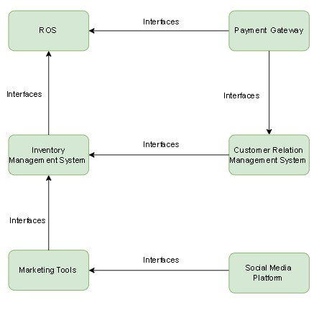
Ecosystem Map

Slide 4
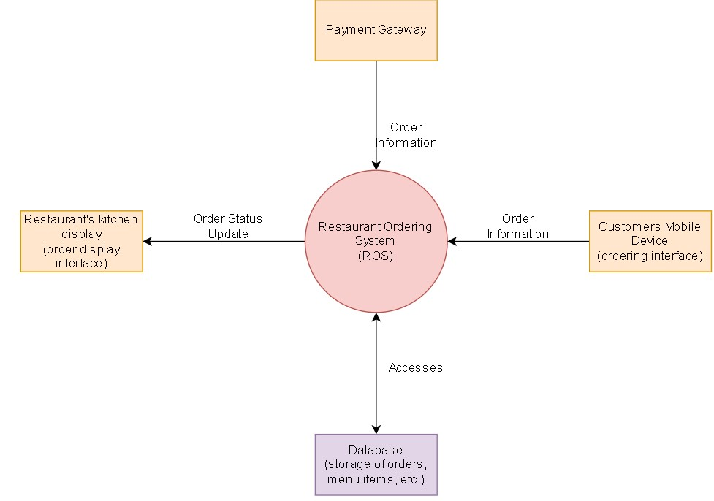
Context Diagram

Slide 5
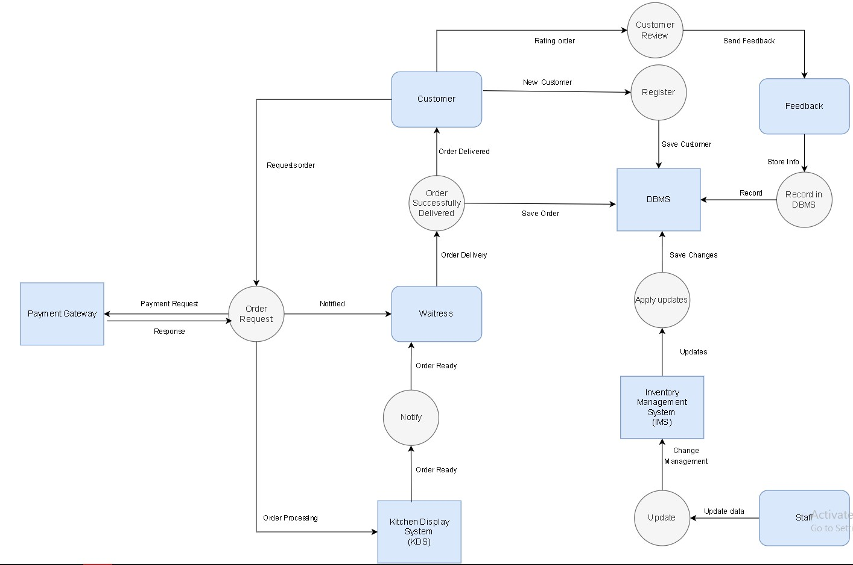
Data Flow Diagram

Slide 6
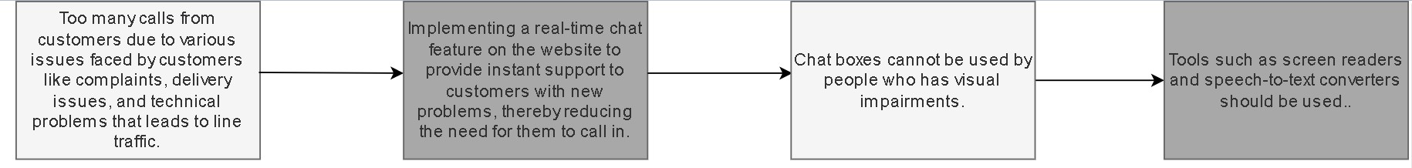
Business Objective Model

Slide 7
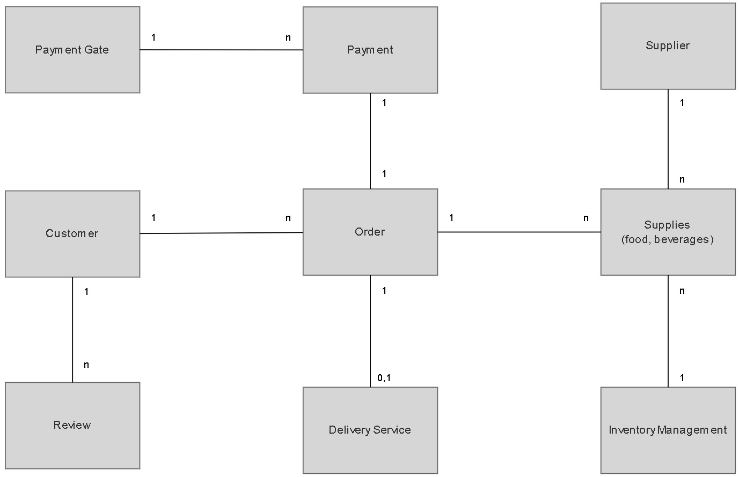
Business Data Diagram

Slide 8
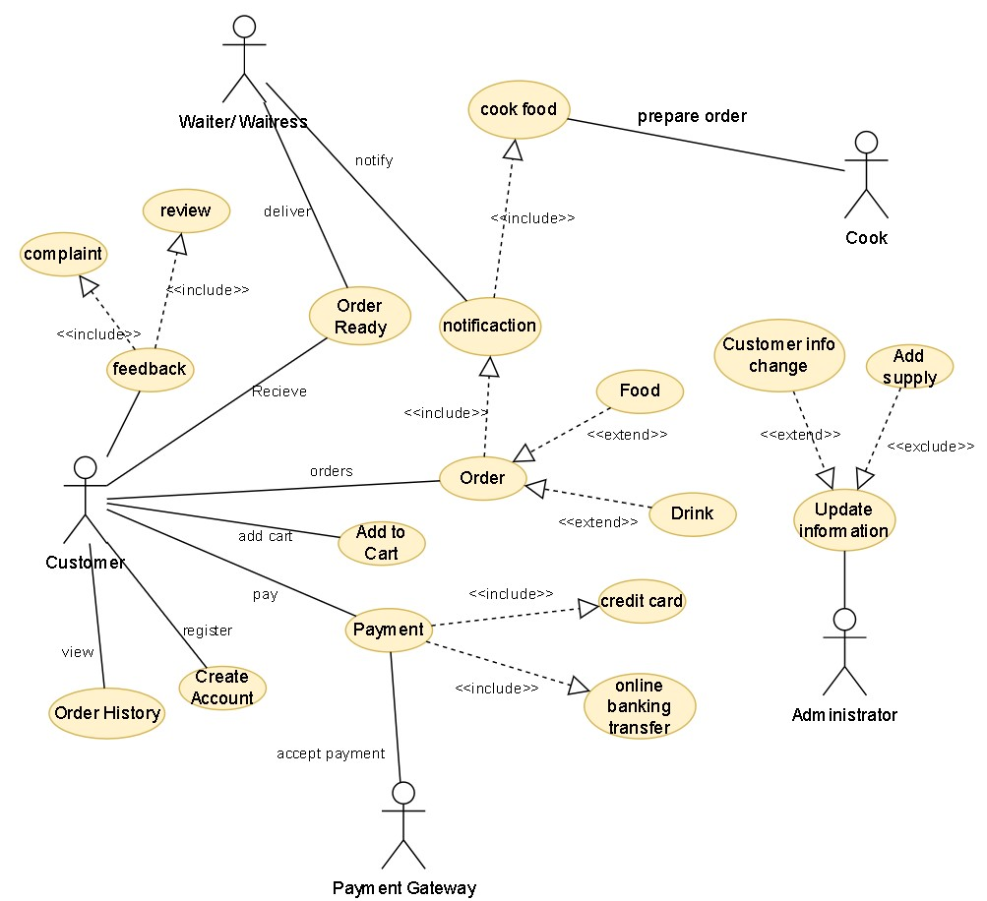
Use Case Diagram

